Slide 1
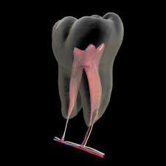
PRINCIPALS OF ACCESS CAVITY PREPARATION

Slide 2
DEFINITION
ACP – DEFINED AS THAT ENDODONTIC CORONAL PREPARATION WHICH ENABLES UNOBSTRUCTED ACCESS TO THE CANAL ORIFICE , A STRAIGHT LINE ACCESS TO THE APICAL FORAMEN, COMPLETE AUTHORITY OVER THE ENLARGING INSTRUMENT AND TO ACCOMMODATE THE FILLING TECHNIQUE

Slide 3
ACCESS CAVITY
The opening prepared in a tooth to gain entrance to the root canal system for the purpose of cleaning ,shaping and obturating.
AAE , Glossary of Endodontics

Slide 4
IDEALS OF ENDODONTICS ACCESS
STRAIGHT LINE ACCESS
REMOVALOF CORONAL PULP
COMPLETE REMOVAL OF PULP CHAMBER ROOF

Slide 5
IDEALS ARE BALANCED WITH ……..
CONSERVATION OF TOOTH STRUCTURE
RETENTION
AETHETICS
FINAL RESTORATION

Slide 6
OBJECTIVES
1. Unroofing of chamber and exposure of pulp horns : help in
Maximum visibility.
Location of canals.
Easy instrumentation of canals
Permits straight line preparation

Slide 7
2. Straight line access : Helps in
3.Conservation of tooth structure : Helps in
Improved instrument control.
Improved obturation.
Decreased procedural errors
Minimal weakening of tooth.
Prevention of perforation

Slide 8
Principles of Endodontic Cavity Preparation:
I. Outline Form
II. Convenience Form
III.Removal of the remaining carious dentin and defective restorations.
IV.Toilet of the cavity/ Cleaning the pulp Chamber
Endodontic radicular cavity preparation - Resistance & retention form to the preparation
Endodontic Coronal Cavity Preparation

Slide 9
Principle I: Outline Form
Establish complete access for instrumentation, from cavity margin to apical foramen
External outline form = internal anatomy of pulp
Three factors of internal anatomy must be considered
Size of the pulp chamber,
Shape of the pulp chamber,
Number of individual root canals, their curvature, & their position.

Slide 11
MORPHOLOGY of the pulp chamber
Two Categories of anatomic patterns were observed:
Relationships of pulp chamber to the clinical crown
Relationship of the orifices on the pulp chamber floor.

Slide 12
Relationships of pulp chamber to the clinical crown
Law of centrality - the floor of the pulp chamber is always located in the center of the tooth at the level of CEJ.
Law of concentricity – the walls of the pulp chamber are always concentric to the external surface of the tooth at the level of the CEJ
Law of CEJ – the CEJ is the most consistent, repeatable landmark for locating the position of the pulp chamber

Slide 13
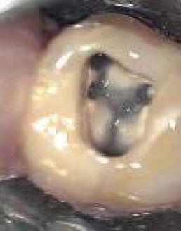
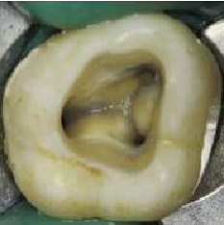
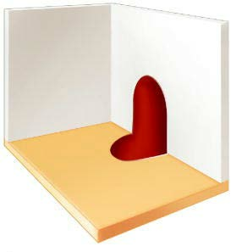
Relationship of the orifices on the pulp chamber floor
The floor of the pulp chamber is always a darker color than the surrounding dentinal walls.
The orifices of the root canal are always located at the junction of the walls and floor.
Reparative dentin or calcifications are lighter than the pulp chamber floor
The developmental root fusion lines forms a “dentinal map” joining the orifice of root canal on the pulpal floor are darker than the floor color.

Slide 14
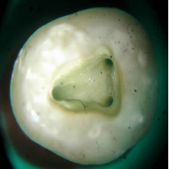
Number, Position and Curvature of root canals
The cavity walls must be extended to allow an unstrained instrument approach.
Radiographs & thorough clinical exploration of the interior & exterior of the tooth – accurate evaluvation of the root canal anatomy .

Slide 15
Principle II: Convenience form:
Unobstructed access to the canal orifice,
Direct access to the apical foramen,
Cavity expansion to accommodate filling techniques
Complete authority over the enlarging instrument.

Slide 16
Instrument impingement occurs due to severely curved root/ an extra canal – the proposed extension of only that portion of wall where extra canal is present & this results in clover leaf appearance of outline form / shamrock preparation

Slide 17
If the lateral wall of the cavity is not sufficiently extended & pulpal horn portion of orifice still remains in the wall , the orifice appears like a “mouse hole “
This lateral wall will impinge on the enlarging instrument & dictate the direction of the instrument tip . It is eliminated by extending the lateral wall

Slide 18
Principle III: Removal of the Remaining Carious Dentin and Defective Restorations
To eliminate mechanically as many bacteria as possible from the tooth
To eliminate discolored tooth structure
To eliminate the possibility of any bacterial laden saliva leaking into the prepared cavity
If one wall of the access cavity is missing – wall should be built up

Slide 19
Principle IV: cleaning of the Cavity
All of the debris, and necrotic material must be removed, before the radicular preparation is begun.
Large blade spoon excavator, copious irrigation with sodium hypochlorite etc,.

Slide 20
Principle V – Endodontic radicular cavity preparation
Resistance form – is defined as development of an apical stop at CDJ against which filling is to be compacted & acts as a stop to resist extrusion of canal debris & filling material
Retention form - is established to retain primary filling within the root canal system
Outline form – of the radicular cavity preparation is dictated by the external anatomy of the tooth

Slide 21
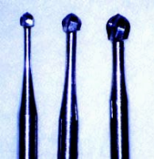
Classification of access cavity preparation instruments
According to the use in the procedure of access cavity preparation-
1. Initial preparation
Round end tapered tungsten carbide bur
Round end tapered diamond points
Trans-metal bur used for access cavity preparation through a crown

Slide 22
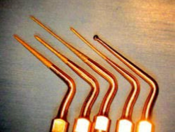
2. Unroofing the pulp chamber
Endo Z bur - Long tapered ,Round non cutting safe ended tip
Round bur multi fluted – for metal penetration & caries removal
Ultra sonic tips

Slide 23
3. Canal orifice flaring instruments
Gates glidden drills
Peeso reamers
Orifice openers & wideners
Ultrasonic tips
Rotary system – orifice shapers with greater taper of 0.08, 0.10, 0.12

Slide 24
4. Endodontic path finder
Endodontic explorer – DG-16, CK -117 – sharper , thinner & more flexible
Stewart probe
Path finder
Mueller bur – remove the obstruction to canal orifice - extended shank round bur with extra long shank
Micro opener
Ultrasonic tips

Slide 25
5.VISION , MAGNIFICATION ,ILLUMINATION
Fiberoptic endoscope (orascope)
Surgical operating microscope
Dental surgical loupes

Slide 26
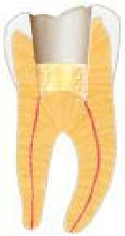
Aids in locating canals
Pretreatment radiographs in 2 different angulations – no .of canals & internal anatomy
Endodontic explorer , sharp spoon excavator
Visualization of canal bleeding points
Presence of dark lines on the floor of the pulp chamber(dentinal map).
A drop of methylene blue on the floor of the pulp chamber.
Use of fiber optic on buccal or lingual surface, either directly or indirectly.
Magnification and illumination
Champagne Bubble Test -• Use of sodium hypochlorite in the pulp chamber to check for bubbles

Slide 27
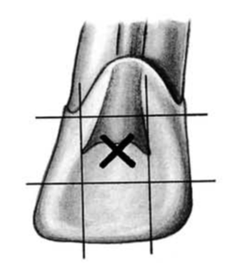
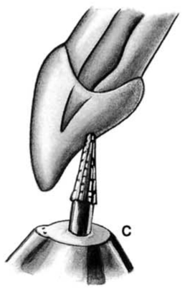
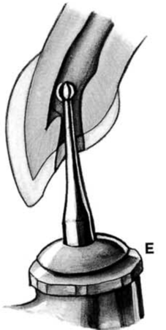
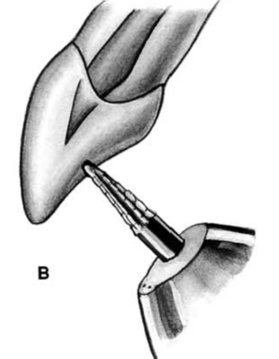
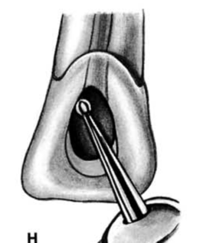
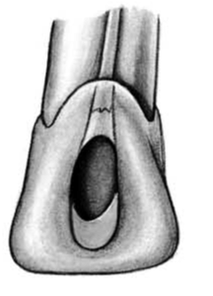
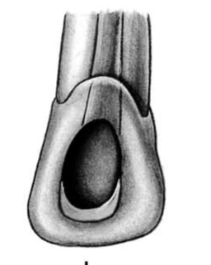
Access Cavity Preparation In MAXILLARY ANTERIOR TEETH
Initial penetration is
made at the exact center of lingual surface
Round pointed taperingFissure - at right angle to the long axis of the tooth
Rotate the handpiece to the incisal so that the bur is parallel to the long axisof tooth
A drop of the bur is felt
No: 1 or 2 round bur used
laterally and incisally to
eliminate pulp horn debris
ovoid
Triangular internal anatomy

Slide 28
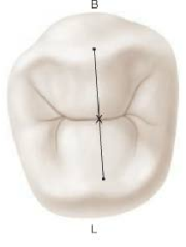
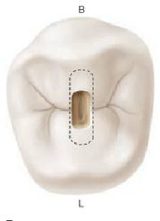
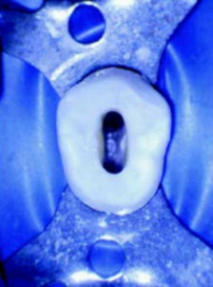
Access Cavity Preparation In MAXILLARY PREMOLARS
Access starting location point is on central groove between cusp tip

Slide 29
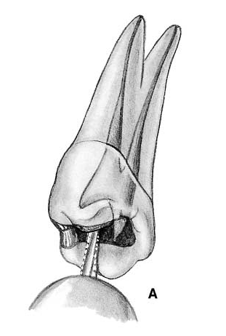
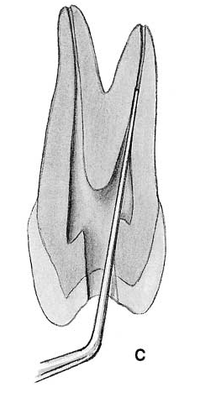
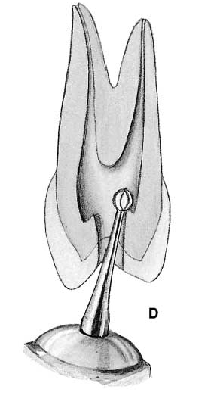
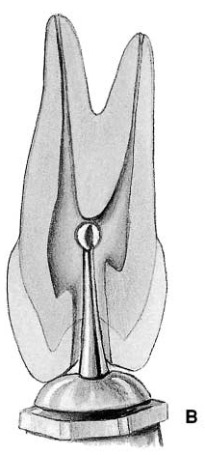
Access Cavity Preparation In MAXILLARY PREMOLARS
Initial penetration made with bur parallel long axis of tooth
Canal orifices located
using endodontic
explorer
No. 2/4 round bur, drop is felt when pulp chamber is reached
Removal of roof of pulp chamber

Slide 30
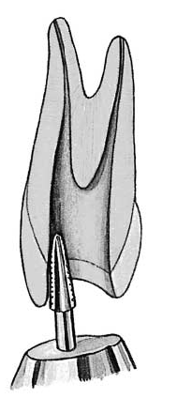
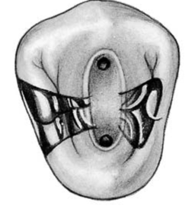
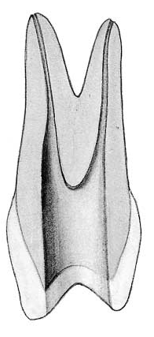
Access Cavity Preparation In MAXILLARY PREMOLARS
Buccolingual extension
and finish of cavity walls
using fissure bur
Outline form of final
cavity preparation –
ovoid
Final preparation should
provide unobstructed
access to canal orifice

Slide 31
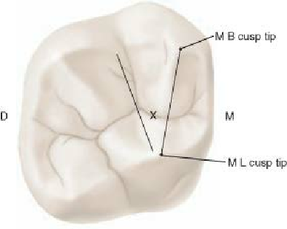
Access Cavity Preparation In MAXILLARY MOLARS
-
•
Mesial
and Distal
boundary should be established
boundary
mesial cusp tips
- is the line connecting
•
Mesial
•
Distal
boundary -
-oblique ridge

Slide 32
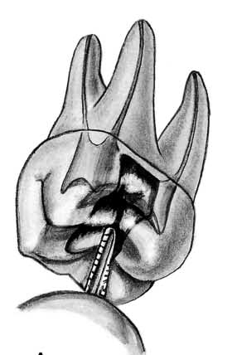
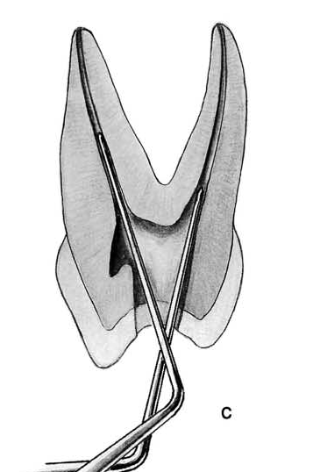
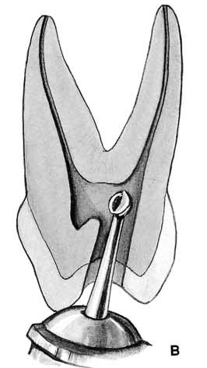
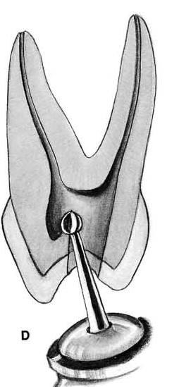
Access Cavity Preparation In MAXILLARY MOLARS
Initial penetration made
at the center of occlusal
pit with bur directed
palatally
Endodontic explorer used to locate canal orifices
No. 4 round bur directed to
the palatal canal orifice or
mesiobuccal orifice
Round bur is used to
remove roof of the pulp
chamber

Slide 33
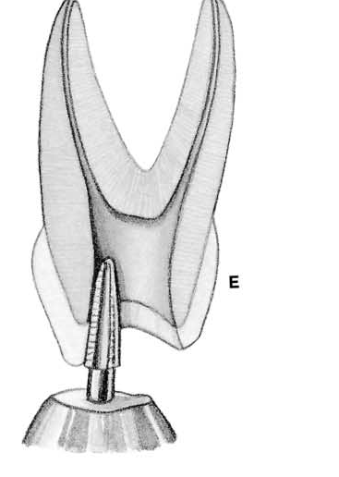
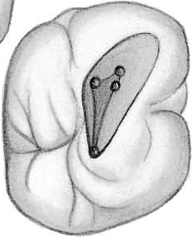
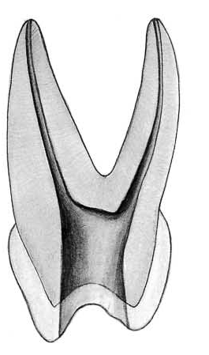
Access Cavity Preparation In MAXILLARY MOLARS
Final finish & funnelling
of cavity walls with
tapered diamond point
Outline form of final cavity preparation – Triangular
Final preparation provide ease of access improved by leaning the preparation to the buccal

Slide 34
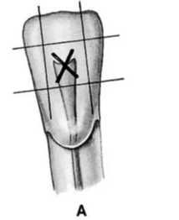
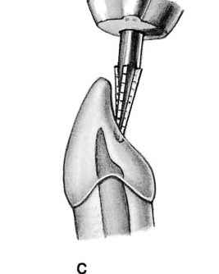
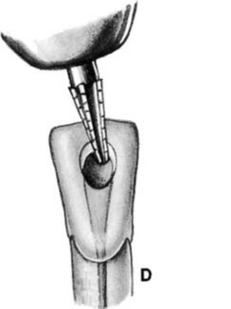
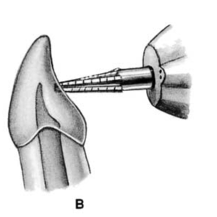
Cavity Preparation In MANDIBULAR ANTERIOR TEETH
Initial penetration is made at the exact center of lingual surface
Rotate the handpiece to the incisal so that the bur is parallel to the long axis of tooth
Round pointed tapering fissure bur in an accentuated speed
handpiece at right angle to the long axis of the tooth
Preliminary cavity outline funnelled and fanned incisally with a fissure bur

Slide 35
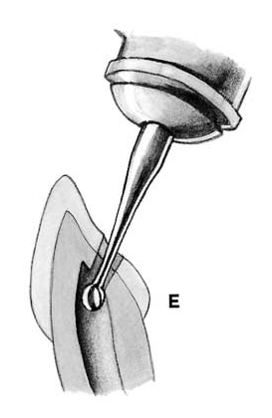
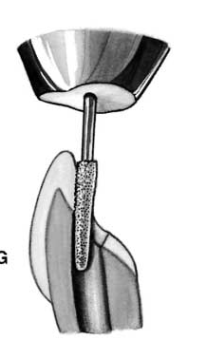
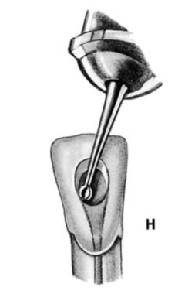
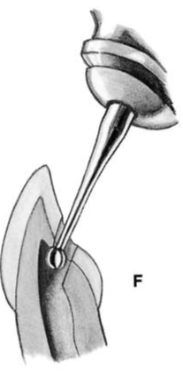
Cavity Preparation In MANDIBULAR ANTERIOR TEETH
No. 2 round bur in a slow speed hand piece is used to penetrate the pulp chamber
Working from inside outside tapered diamond point is used to remove the lingual shoulder
to
penetrate
chamber
the
pulp
used
remove
lingual shoulder
Working from inside outside , a round bur is used to remove the lingual & labial walls of the pulp chamber
to
the
No. 1 round bur
Used laterally & incisally to eliminate pulp horn and debris
Working
to
outside, a round bur is used
from
inside
No:
1
round
bur
to
remove
the
of
lingual
&
pulp
eliminate
debris
pulp
horn
labial
walls
chamber
the
Dr. Nithin Mathew - Root Canal Morphology & Access Preparation

Slide 36
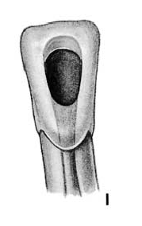
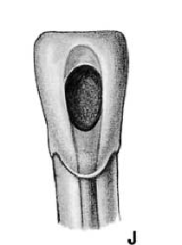
Cavity Preparation In MANDIBULAR ANTERIOR TEETH
Cavity preparation in adult- ovoid
Final preparation: triangular internal anatomy in young teeth
Dr. Nithin Mathew - Root Canal Morphology & Access Preparation

Slide 37
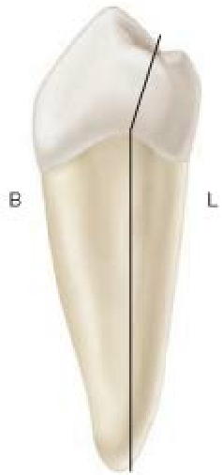
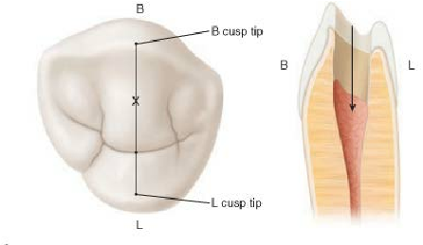
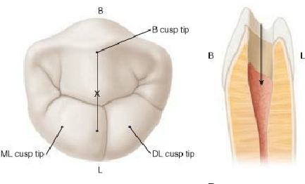
Access Cavity Preparation In MANDIBULAR PREMOLARS
Mandibular premolar-tilted lingually to root and must be adjusted to this tilt
Ist PREMOLAR
Halfway up the lingual incline on a line
connecting cusp tips
2ND PREMOLAR
1/3RD way up the lingual incline of the buccal cusp on a connecting buccal tip & lingual groove between the linguaL cusps
2ND PREMOLAR
1/3
rd
way up the lingual
incline of
buccal

Slide 38
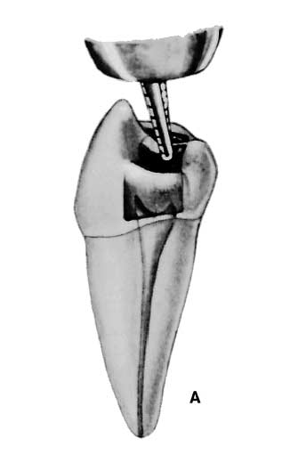
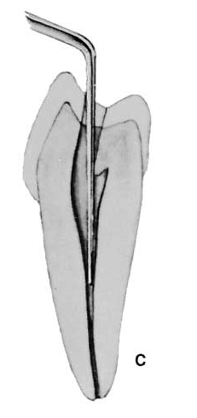
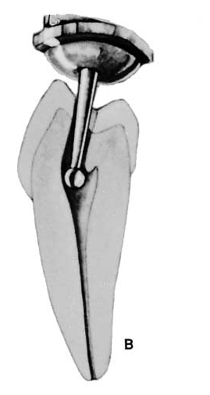
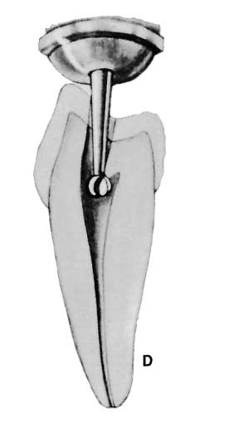
Access Cavity Preparation In MANDIBULAR PREMOLARS
Initial penetration made through occlusal surface
Canal orifices located
using endodontic
explorer
No. 4 round bur, drop is felt when pulp chamber is reached
Removal of roof of pulp
chamber

Slide 39
Access Cavity Preparation In MANDIBULAR PREMOLARS
Buccolingual extension
and finish of cavity walls
using fissure bur
Outline form of final cavity
preparation – ovoid
Final preparation should
provide unobstructed
access to canal orifice

Slide 40
Access Cavity Preparation In MANDIBULAR MOLARS
Mesial
and Distal
boundary should be established
•
Mesial & distal boundary should be established.
Mesial boundary for mandibular molars are lines connecting mesial cusp tips
Distal – is the line connecting buccal & lingual grooves
boundary for
cusp tips
•
Mesial
mandibular
molars are line connecting mesial
•
Distal

Slide 41
Access Cavity Preparation In MANDIBULAR MOLARS
Initial penetration made
at the center of mesial pit
with bur directed towards distal
Endodontic explorer used
to locate canal orifices
No. 4/No.6 round bur is used, directed towards the orifice of mesiobuccal or distal canal
Round bur is used to
remove roof of the pulp chamber

Slide 42
Access Cavity Preparation In MANDIBULAR MOLARS
Final preparation provide
ease of access improved by
leaning the preparation to
the buccal
Final finish & funnelling
of cavity walls with
tapered diamond point

